Slide 1
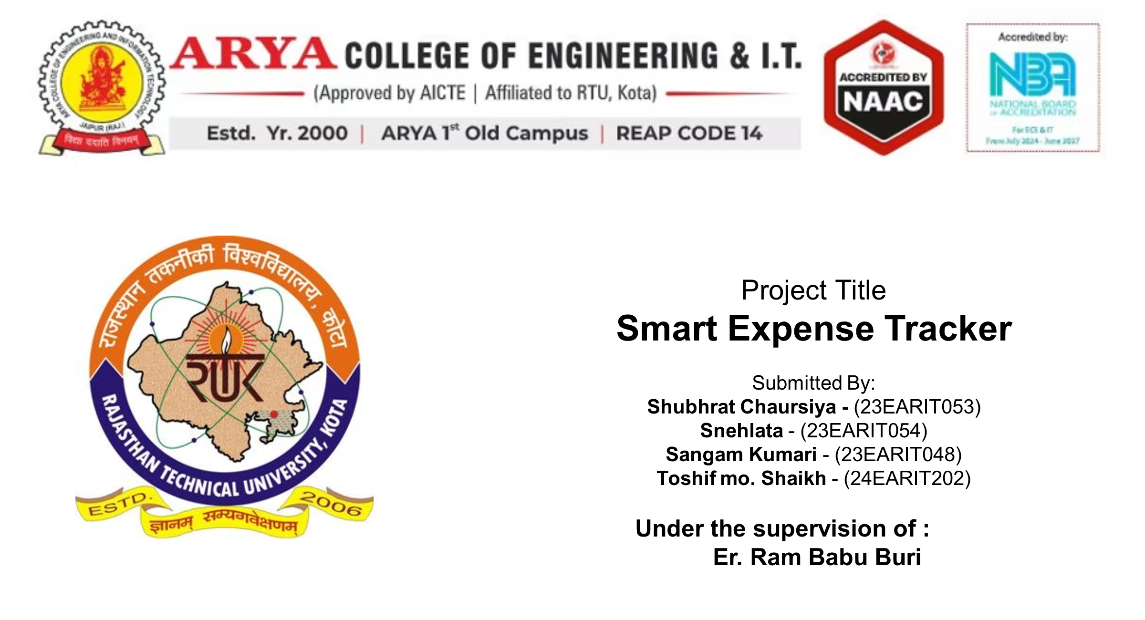

Slide 2

PROJECT OVERVIEW :
Purpose: Expense-tracker-java is a desktop application for personal finance: to record, track, and manage your incomes & expenses.
It’s meant as a simple but functional “expense and income management” tool: users can log transactions, view balance, browse history, and export reports.
The project is open-source

Slide 3


PROGRAMMING LANGUAGE & UI :
The application is written in Java — the entire codebase is Java.
For the graphical user interface (GUI), it uses Java Swing.
It expects Java 8 or later to run (i.e. requires a standard Java Development Kit).

Slide 4

DATA STORAGE :
The project uses MySQL for database management — to store user accounts, transactions, and related data.
There is a clear separation in project structure: a “backend” package handles database connectivity, data storage, and data flow utilities.

Slide 5
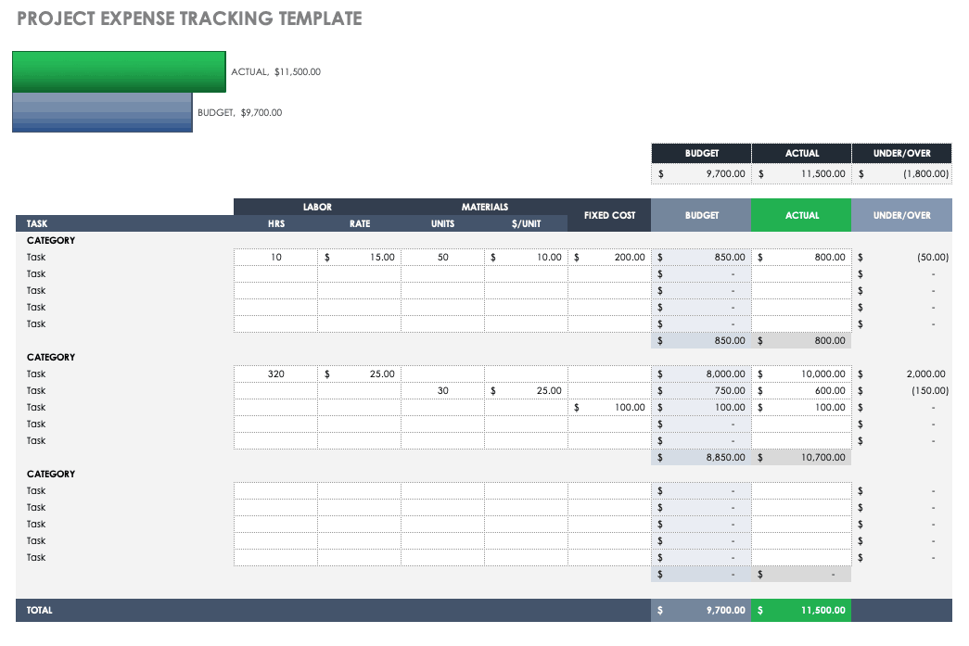
PROJECT STRUCTURE :
The source code lives in a directory with subpackages, typically: backend/, frontend/, main/, and test/.
  frontend/ → GUI frames, panels, UI components.
  backend/ → database connectors, data storage and flow logic.
  main/ → contains the main method (program entry point).
  test/ → unit tests / test resources (if any).

Slide 6
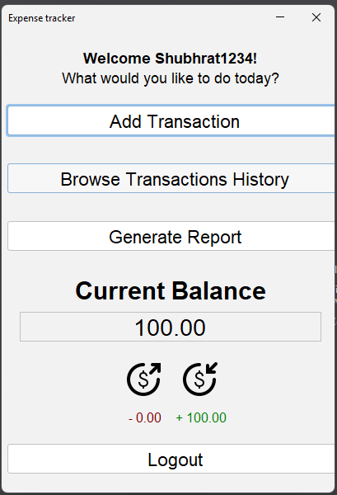
HOW IT WORKS :
On launching the app, user gets option to Login or Create an Account (if first time).
After login → the Main Frame / Dashboard is shown:
  Displays the logged-in user’s name.
  Shows current balance, aggregated totals for income and expenses.
  Provides buttons/controls to manage transactions (add, view history, export, logout).

Slide 7
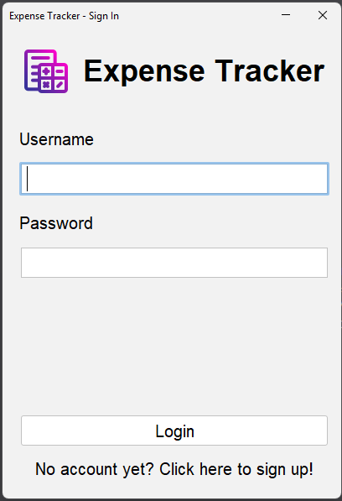
LOGIN & DASHBOARD :
On launching the app, user gets option to Login or Create an Account.
After login → the Main Frame / Dashboard is shown:
Displays the logged-in user’s name.
Shows current balance, aggregated totals for income and expenses.
Provides buttons/controls to manage transactions (add, view history, export, logout).

Slide 8
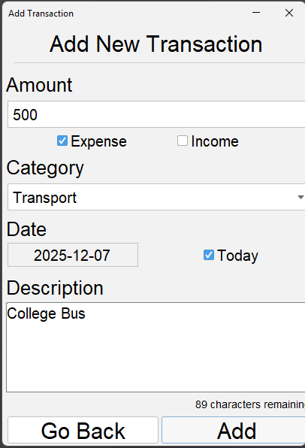
TRANSACTION MANAGEMENT :
Add Transaction: User can add a new transaction specifying:
Amount
Type: Income or Expense
Category: chosen via a combo-box
Date: with default to today’s date
Description: optional textual description.
View Transaction History: Users can browse previous entries: each transaction appears as a “card” in UI.
Or delete a transaction — removing from history and database.

Slide 9

FEATURES :
Users can generate and save reports / exports of their transactions
Supported export formats: CSV, PDF, XLSX (Excel), and TXT. This gives flexibility to analyze data in spreadsheets or share easily.
That means besides just tracking, users can maintain backups, print or share their financial history, or do further analysis externally.

Slide 10


